Slide 1
A Study Of
The Book Of Revelation
September 20, 2020

Slide 2
Resources used:
A Study Of The Book Of Revelation by Bob Dodson
More Than Conquerors by William Hendriksen
Overcoming With The Lamb, Florida College Annual Lectures, February 7-10, 1994
Revelation: An Introduction and Commentary by Homer Hailey
Revelation (Truth Commentaries) by Robert Harkrider
Revelation (A Study Workbook) by Robert Harkrider
Revelation by Donnie Rader
Revelation charts by Keith Greer.
Studies In The Book Of Revelation by Ferrell Jenkins
The Old Testament In The Book Of Revelation by Ferrell Jenkins
The Revelation Of Saint John The Divine by G.B. Caird
The Book of Revelation by Foy E. Wallace
The Avenging of the Apostles and Prophets by Arthur M. Ogden
Worthy Is The Lamb by Ray Summers
Written exchange on “The Domitian Persecution” between Arthur M. Ogden and Ferrell Jenkins presented in Searching The Scriptures, June 12, 1989, pages 7-12

Slide 3
Revelation
I. Struggle on Earth (1-11)
A. John’s Vision (1)
B. Letters to 7 churches (2-3)
Character, temptations, and rewards of the church
C. Sovereign God in control
Redemption through the Lamb (4-5)
D. Opening of seven seals
  Suffering church, divine judgments,
  ultimate triumph of Christ (6-11)

Slide 4
Revelation 6
Context: The Scroll
Written to capacity
Complete – lacking nothing
7 seals – completely sealed
What is the Message Within?
The future of God’s people and their struggle
God’s eternal purpose (cf. verse 9)
See the message: chapters 6-11

Slide 5
Revelation 6
“Opening of Six Seals”
Outline
First Seal – White Horse and Rider (Victory) – (verses 1-2)
Second Seal – Red Horse and Rider (War) – (verses 3-4)
Third Seal – Black Horse and Rider (Famine) – (verses 5-6)
Fourth Seal – Pale Horse and Rider (Death) – (verses 7-8)
Fifth Seal – Souls Under The Altar (Persecution) – (verses 9-10)
Sixth Seal – Shakeup Of Nature (Judgment) –
(verses 12-17)

Slide 6
Revelation 6
“All of the above – military conquest, war, famine, pestilence – are forces God can use to destroy the oppressors of his people. His Christians are to take courage. Their cause is not lost by any means.”
Ray Summers, Worthy is the Lamb, Page 142

Slide 7
Revelation 6
What Is The Point?
God’s control (4-5) brings destruction upon the enemies of God’s people.
“Under any condition this part of the pageant symbolizes God’s destructive power against those who reject him and his plan of salvation. As these forces – conquest, war, famine, pestilence, natural calamity – rage, ‘who shall be able to stand?’”
– Ray Summers, Worthy is the Lamb, Page 145

Slide 8
Significance of Numbers
1 – Unity (Deuteronomy 6:14) One Jehovah God.
2 – Strength (Revelation 11:3)
3 – Divine number (see Matthew 28:19)
4 – Nature, Creation, World (Revelation 7:1)
5 – The whole man is represented by this number example (Revelation 17:10)
6 – Short of 7 – failure (Revelation 13:18)
7 – Completeness – perfection, totality, sometimes the combination of 3 and 4
10 – Power – world power. Number 5 multiplied twice. Refer to Revelation 13:1. Ten horns.
1000 – Multiple of 10 X 10 X10. Whole or fullness
12 – Religious number
3 ½ – 42 months; 1260 days (Revelation 12:14).
Broken 7 – incomplete – indefinite period

Slide 9

Revelation 6:1
Revelation 6
“And I saw when the Lamb opened one of the seven seals, and I heard one of the four living creatures saying as with a voice of thunder, Come.”

Slide 10
Four Living Creatures
Revelation 4:7-8
Revelation 4 and 5
“Full of eyes” – all-seeing ability
“Cherubim” (Ezekiel 1:5ff; 10:5, 10, 18, 20) “Seraphim” (Isaiah 6:1,2)
“Lion” – strength
“Calf” – service
“Man” – intelligence
“Flying Eagle” – velocity and swiftness
These living creatures are special servants of God – strong, swift, intelligent, and always vigilant. Beings of the highest order that guard holy things of God and never fail to worship.

Slide 11
Scroll/Book –
“Destiny of the Church”
Revelation 6
Only the Lamb is worthy to open the sealed book.
John sees the Lamb open the first seal of the scroll with “seven seals.” This is the first of a series of three “sevens”
  Seven seals (6:1-8:5)
  Seven trumpets (8:6-9:21)
  Seven bowls of wrath (15:1-16:21).
Four corners of the earth – four winds of the earth –
God’s judgment going out into the world. (7:1)
“Come (and See)” KJV – a thundering voice enabling John to observe the proceeding. (Chapter 6)

Slide 12
Revelation 6:2
Revelation 6
“ And I saw, and behold, a white horse, and he that sat thereon had a bow; and there was given unto him a crown: and he came forth conquering, and to conquer.

Slide 13
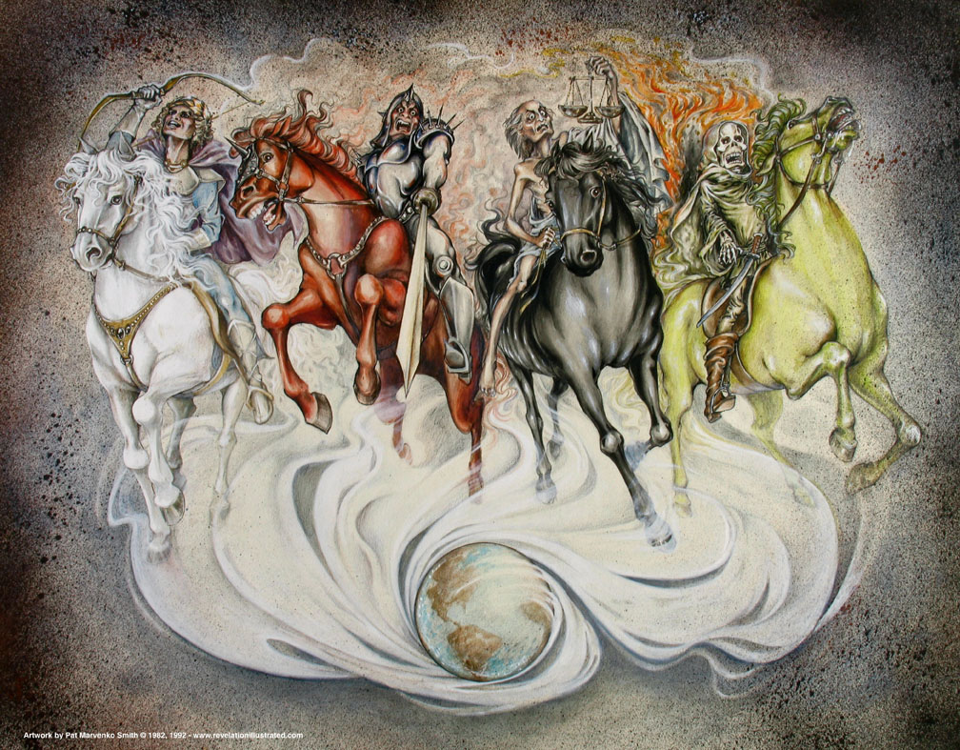
Revelation 6

Slide 14
Revelation 6
“The horse is portrayed in the Old Testament as the noblest of animals. (Gen. 49 :17; Job 39 :19-25) The beasts of burden were oxen and asses, horses were warriors, reserved for the arsenals of war, used by kings, either mounted or harnessed to chariots. (Ex. 9:23 ; Esther 6 :8)”
“Solomon imported them from Syria and Egypt. (I Kings 4:26; 10 :26, 29; II Chron. 1:14-17; II Chron. 9:25) They were here in the apocalypse employed under different colors to represent the character of the event as Zech. 1:8 ; 6:2-6, and to signify the fleetness and the strength to represent angels.” (Foy E. Wallace)

Slide 15
First Seal –
“White Horse and Rider”
Revelation 6
White – holy (purity)
  White horse symbol of conquest, military, armed strength.
  Some think this is Christ. (cf. 19:11) Jesus Christ is portrayed sitting upon a white horse and wearing on his thigh the name, “King of kings, and Lord of lords” (19:16; 17:14).
  Some think it is not Christ, perhaps an opposing army. (No name given.) Christ has a sword (19:11-16).
Equipped with a bow
  No one escapes (Psalms 45:3-5; Habakkuk 3:9, 11) means of conquest.
Crown of victory
  stephanos (2:10; 3:11)
Went out conquering. (cf. Heb. 2:14-15).
  Christ and his followers will be victorious; they will “conquer,” “overcome,” and “reign” (3:21; 17:14).

Slide 16
Revelation 6:3-4
Revelation 6
“And when he opened the second seal, I heard the second living creature saying, Come.
And another (horse) came forth, a red horse: and to him that sat thereon it was given to take peace from the earth, and that they should slay one another: and there was given unto him a great sword.”

Slide 17
Second Seal –
“Red Horse and Rider”
Revelation 6
“Fiery red”
Red – the color of fire and blood.
  Strife, war, things associated with war, persecution follow the preaching of the gospel. (1 Timothy 3:12)
Power given for its rider to take peace away from the earth.
He was given a “great sword.” (cf. Matthew 10:34)
People would kill one another.
Conflict with those who had the gospel message.

Slide 18
Revelation 6:5
Revelation 6
“ And when he opened the third seal, I heard the third living creature saying,
Come.
And I saw, and behold, a black horse; and he that sat thereon had a balance in his hand.”

Slide 19
Revelation 6:6
Revelation 6
“And I heard as it were a voice in the midst of the four living creatures saying, A measure of wheat for a shilling, and three measures of barley for a shilling; and the oil and the wine hurt thou not.”

Slide 20
Third Seal –
“Black Horse and Rider”
Revelation 6
Black – the color of mourning and grief
“The black horse was the color of distress, the portent of terror in the approaching calamity. It compares with the Old Testament figure in
Joel 2:6, “The people shall be much pained, all faces gather blackness” and in
Nahum 2:10, “The faces of them all gather blackness” and in
Jeremiah 8 :21, “For the hurt of my people am I hurt, I am black.”
Jude 13, refers to the “blackness of darkness forever.” It is the picture of the grim, dread calamity of famine in the land.”
(Foy E. Wallace)

Slide 21
Third Seal –
“Black Horse and Rider”
Revelation 6
“Pair of scales” in the hand of the rider
“Denarius” – shilling – penny a full day’s wages (Matthew 20:2).
“Oil and Wine” in abundance. The comforts of life, were not affected.
“Black” is a sign of hunger
Economic discrimination – trade guilds
Conditions in which Christians would live because of their persecution

Slide 22
Third Seal –
“Black Horse and Rider”
Revelation 6
This follows the rider of the “red horse” – bloodshed.
Pressure to conform would be brought on Christians.
They would be prevented from selling or buying.
They would undergo famine, peril, and shortages.
All brought to bear because of their faithfulness to the Lord!
“Famine always follows in the wake of war.”
(Ray Summers, Worthy is the Lamb, Page 141)

Slide 23
Revelation 6:7
Revelation 6
“And when he opened the fourth seal, I heard the voice of the fourth living creature saying, Come.”

Slide 24
Revelation 6:8
Revelation 6
“And I saw, and behold, a pale horse: and he that sat upon him, his name was Death; and Hades followed with him. And there was given unto them authority over the fourth part of the earth, to kill with sword, and with famine, and with death, and by the wild beasts of the earth.”

Slide 25
Fourth Seal –
“Pale Horse and Rider”
Revelation 6
“Ashen” (pale) horse
Rider is “Death” acting by way of a sword.
“Hades” followed him – death slays and Hades reaps. Hades always follows death.
“Ashen,” the color of death
The One breaking the seal gave “them” (death and hades) authority to kill …
  Sword, famine, and death, and by the wild beasts (Wallace suggest this was cannibalism) of the earth.
  Common woes or pestilence afflicting mankind in general (Ezekiel 14:21).
A “fourth of the earth.” Limited to only a portion – not complete judgment

Slide 26
Fourth Seal –
“Pale Horse and Rider”
Revelation 6
Many Christians would be killed during this great tribulation.
Righteous retribution poured out on the ungodly – the innocent also suffer!
Unite the people of God and bring them closer to Him.

Slide 27
Revelation 6:9
Revelation 6
“And when he opened the fifth seal, I saw underneath the altar the souls of them that had been slain for the word of God, and for the testimony which they held”

Slide 28
Revelation 6:10
Revelation 6
“and they cried with a great voice, saying, How long, O Master, the holy and true, dost thou not judge and avenge our blood on them that dwell on the earth?”

Slide 29
Revelation 6:10
Revelation 6
Perhaps these are some who had been killed by the persecution under the second seal (6:4).
John himself was exiled for this same cause (1:9).
“How long, O Master, the holy and true, dost thou not judge and avenge our blood on them that dwell on the earth?”
  Avenge suggests the idea of a just punishment, a recompense for wrongdoing (19:2). ekdikeoo, ekdikoo (Thayer)
  a. to vindicate one’s right, to do one justice – Luke 18:3
  b. to avenge a thing – 2 Corinthians 10:6
  This is different from “revenge” which is retaliation.
  (cf. Romans 12:19-21)

Slide 30
Fifth Seal –
“Souls Under the Altar”
Revelation 6
The martyrs for truth – bodies asleep in the grave.
NOTE: Those who were slain have conscious existence after death.
  Ecclesiastes 12:7
Souls of those saints “under the altar”
  Ezekiel 41:22 (Description of the altar)
Blood cries out for righteous vindication
  Genesis 4:10
“Slain because of the word of God”
“Testimony they had maintained”

Slide 31
Fifth Seal –
“Souls Under the Altar”
Revelation 6
Cry to God – for His goodness and reliability
To judge and avenge their blood
Not for revenge but for justice! A just punishment, a recompense for wrongdoing (19:2).
Men receive time to repent, but …
Wanted to know “how much longer” God would be longsuffering to those hurting His children?

